Slide 1
JS Design Pattern Day2
Presented By :Asmaa Ahmed

Slide 2
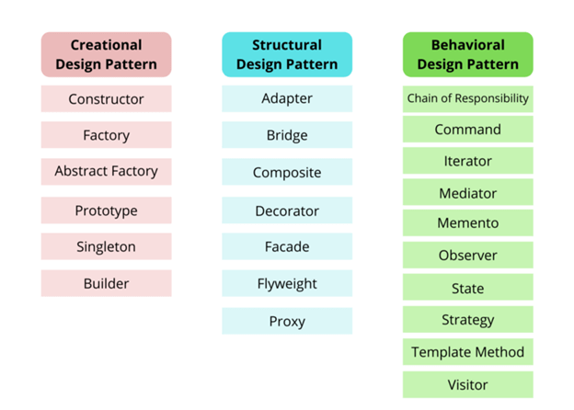
Design Patterns Types

Slide 3
Strategy Pattern
1
The Strategy Design Pattern is a behavioral design pattern. It allows you to dynamically change the behavior of an object by encapsulating it into different strategies. This pattern enables an object to choose from multiple algorithms and behaviors at runtime, rather than statically choosing a single one.

Slide 4
Observer Pattern
2
The observer design pattern enables a subscriber to register with and receive notifications from a provider. It's suitable for any scenario that requires push-based notification. The pattern defines a provider (also known as a subject or an observable) and zero, one, or more observers

Slide 5
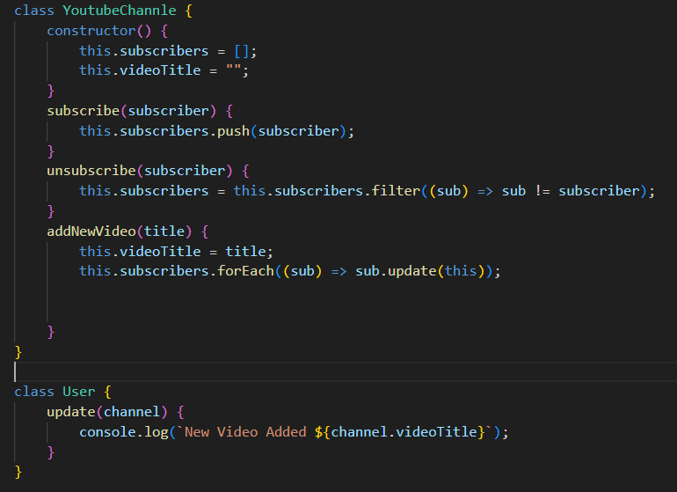
Observer Pattern
2

Slide 6
Solid Principles
SOLID is an acronym for the first five object-oriented design (OOD)
principles by Robert C. Martin (also known as Uncle Bob).
SOLID is an acronym that stands for five key design principles:
● single responsibility principle.
● open-closed principle.
● Liskov substitution principle.
● interface segregation principle.
● dependency inversion principle.
All five are commonly used by software engineers and provide some important
benefits for developers.

Slide 7
Single Responsibility Principle
3
The idea behind the SRP is that every class, module, or function in a program should have one responsibility/purpose in a program. As a commonly used definition, "every class should have only one reason to change".

Slide 8
Open–Closed Principle (OCP)
4
the software entities should be open for extension but
closed for modification.
This implies that such entities – classes, functions, and so on – should be created in a way that their core functionalities can be extended to other entities without altering the initial entity's source code.

Slide 9
Thanks!
Any questions?

